Slide 1
網路最佳化管理
之期末報告

Slide 2
Application 19.20
Dynamic Lot Sizing with Concave Costs
Topic
Application 19.21
Dynamic Lot Sizing with Backorders

Slide 3
Introduction
Reference
A Backlogging Model and a Multi-Echelon Model of a Dynamic
Economic Lot Size Production System-A Network Approach_69
[ Williard I. Zangwill, 1969]
Problem type
Shortest path problem
Dynamic lot-size problem
Many optimization problems in production and inventory planning are
network flows problems.
Notes:
一個產品一階段模型 不缺貨

Slide 4
Introduction
All of models address a basic economic order quantity issue:
- When we plan a production runs
- How much should we produce
Producing in large quantities reduces the time and cost required to set up for the individual. The economic order quantity strikes a balance
between the set up and inventory cost to find the production plan that
achieves the lowest overall costs.
Notes:
大量生產時如何節省時間，各自成本需求的設定

Slide 5
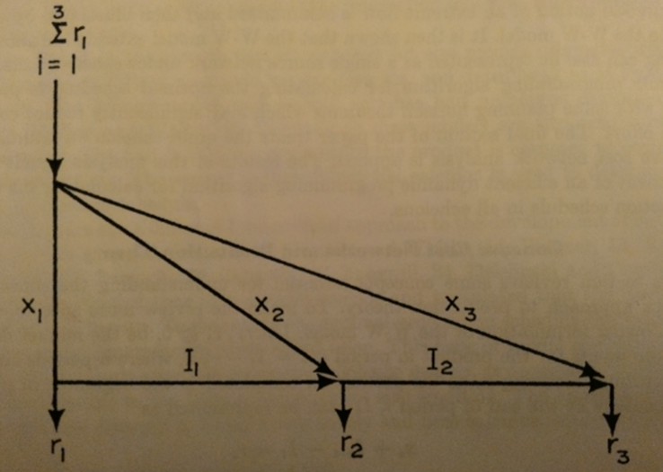
Wanger-Whitin Model
Dynamic Lot Sizing

Slide 6
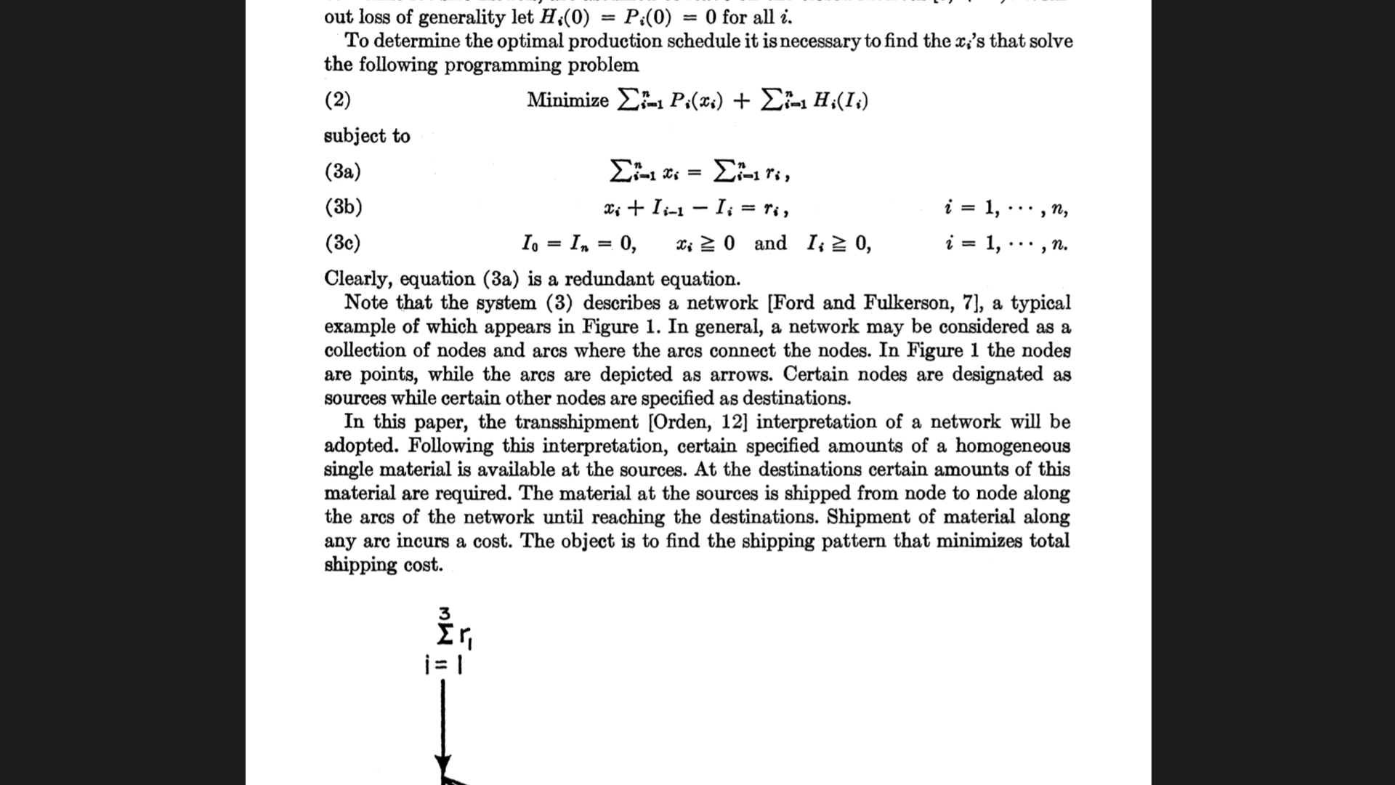
Introduction
Concave costs:
In practice, the production(Xj) in a specific period(j) incurs a fixed cost(Fj)
and a per unit production cost(Cj).
Therefore,
1.the flow cost on the production arc(0,j) is 0, if Xj=0
2.Fj=CjXj , if Xj>0, which is a concave function.
Minimizes the shipping cost
Notes:
model試圖達成

Slide 7
Application 19.20
Dynamic Lot Sizing with Concave Costs
Topic
Application 19.21
Dynamic Lot Sizing with Backorders

Slide 8
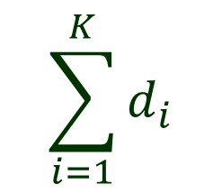
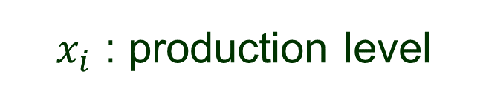
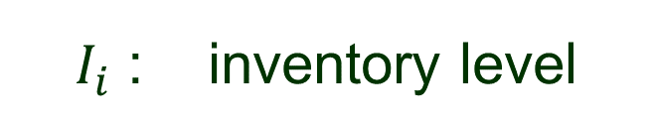




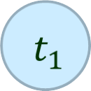
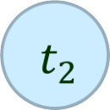
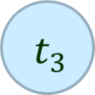
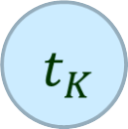






Problem
F

Slide 9





Problem
F

Slide 10
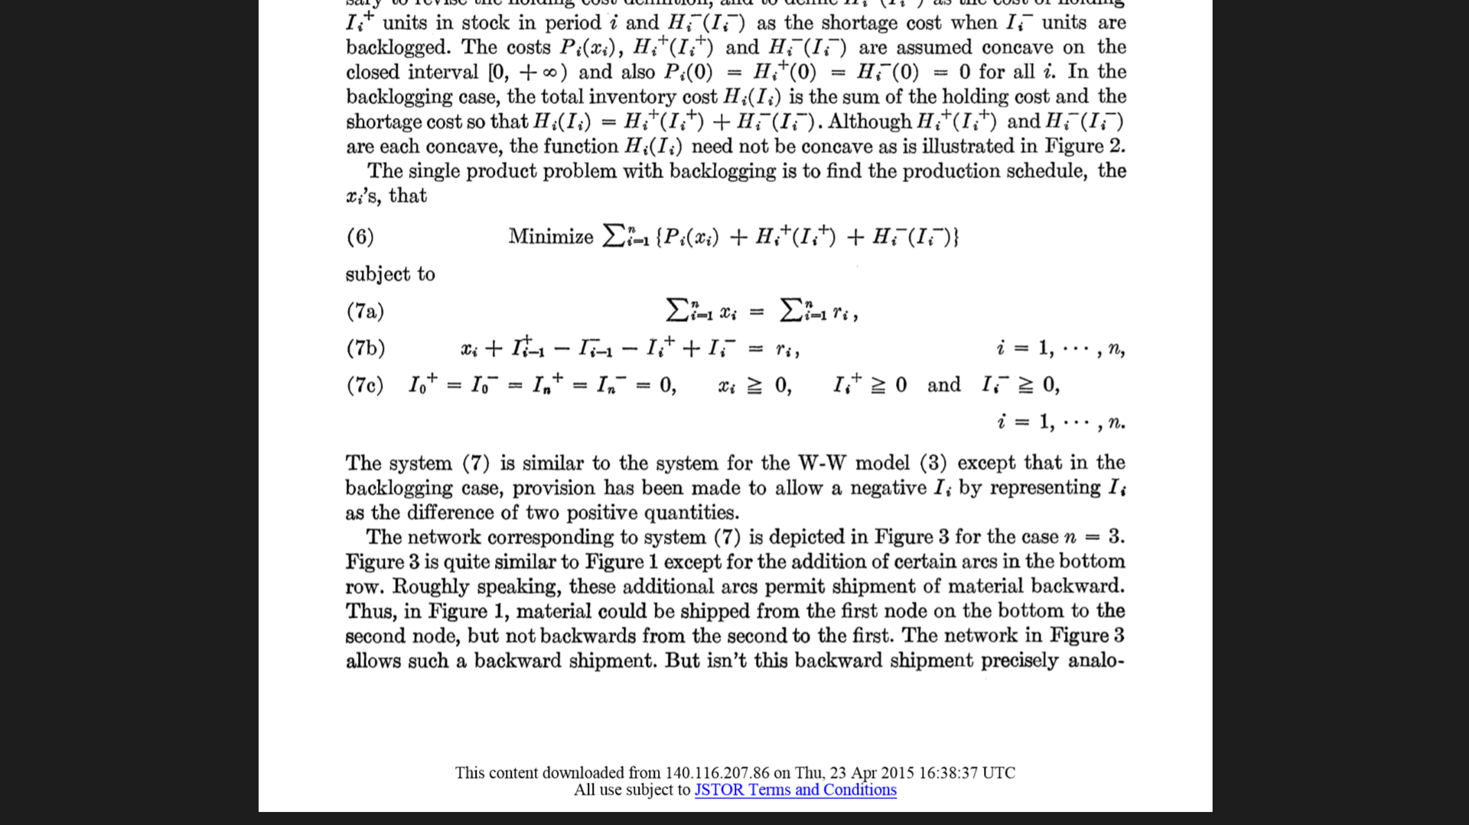
Introduction
Minimizes the shipping cost

Slide 11








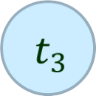

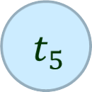

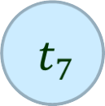








Solution
F

Slide 12
Thank you ~

